Slide 1
Automated Detection, Localization and Removal of Information Exposure Errors
Kommanapalli Vasantha
Department of Computer Science
Technical University of Munich, Germany

Slide 2
Outline
Introduction
Motivating Example
System Overview
Algorithm
Evaluation
Tool Demo
Conclusion and Future Work

Slide 3
Outline
Introduction
Motivating Example
System Overview
Algorithm
Evaluation
Tool Demo
Conclusion and Future Work

Slide 4
Introduction
Sensitive data exposure ranked 6th in the Open Web Application Security Project (AOWASP) top ten list in 2013.
Information exposure through an error message ranked 17th among Common Weakness Enumeration (CWE/SANS) top 25 in 2011.
What is the Problem? Debugging requires significant effort and consumes a lot of time. Even if the bug's cause is known, detecting a bug and generating bug fix patches manually is a tedious task.
Therefore, we need an automated approach to fix the bugs by generating code patches.
Basic program repair consists of:
      Failure Detection.
      Bug Diagnosis.
      Bug Cause Localization.*
      Repair Inference.*

Slide 5
Information Exposure Errors
Definition: The information exposure error is an error in the software which intentionally or unintentionally discloses sensitive information to an user who is not explicitly authorized to have access to that information.
Sensitive information in a program can be leaked in several ways, as for example:
    Through the environmental variables which contain the sensitive information about any remote server.
    Through a log file that was used while debugging the application and later on, the access to that file was not restricted.
    Through a command shell error message which indicates that the web application code has some unhandled exceptions.

Slide 6
Goal of thesis
Problem Statement:
Provide code patches (“in-place” or not “in-place”) which can be used independently to remove an information exposure bug.
Definition of Ideal Code Patch:
An ideal fix covers all bug-triggering inputs and introduces no new bugs. One can determine whether or not a fix resolves a bugs using two criteria:
  Coverage: Many inputs may trigger a bug. The coverage of a fix measures the extent to which the fix correctly handles all bug-triggering inputs.
  Disruption: A fix may unexpectedly change the behavior of the original program. Disruption counts these deviations from the program's intended behavior introduced by a fix.

Slide 7
Available Solutions
Ranking:
Tarantula is a tool which uses a entity (statement, method, branch) ranking mechanism based on the suspiciousness values obtained by executing all the testcases on the entities in the program [1].
Backward Propagation:
Traversing backwards each path belonging to the program execution tree in order to find suspicious nodes (quick fix locations).
1.Jones, James A. and Harrold, Mary Jean,Empirical Evaluation of the Tarantula Automatic Fault- localization Technique, Automated Software Engineering (ASE' 05)

Slide 8
Problems with Available Solutions
The main disadvantage of backward propagation is related to loop unrolling where one has to decide upon the depth of the loop.
Tarantula does not distinguish the contribution of one failed test case from another, or one successful test case from another in finding the fault.
Tarantula needs a test suite in order to find the suspiciousness based on the number of failed and passed test cases available in the test suite.

Slide 9
Our Insight and Approach
Our insight is that statement ranking can be further improved by taking into consideration, the confidential tags attached to the symbolic variables in a program.
Our approach:
  is similar to tarantula but we do not use human written test cases in order to measure the suspiciousness of the program path node.
  is based on the maximum probability of occurrence of a node in all the program execution paths.
  compared to backward propagation does not have to traverse all the nodes located in the program execution path in order to find suspicious nodes.

Slide 10
Contribution
A localizer algorithm used to find bug fix locations.
An algorithm for generating ”in-place” and ”not-in-place” bug fixes.
Source files differential views which depicts the semi-automated patch insertion wizard.
Verifying the behavior of the patched program automatically by re-running the Information exposure checker.

Slide 11
Outline
Introduction
Motivating Example
System Overview
Algorithm
Evaluation
Tool Demo
Conclusion and Future Work

Slide 12
Motivating Example
CWE-526 test programs source:
void CWE526_Info_Exposure_Env_Variables__basic_01_bad(){
/* FLAW: environment variable exposed */
      printLine(getenv("PATH"));
}
CWE-526 test programs sink:
void printLine(const char *line){
if (line != NULL){
printf("%s\n", line);
}
}
Need for localizer!!!
Information exposure bug detected

Slide 13
Outline
Introduction
Motivating Example
System Overview
Algorithm
Evaluation
Tool Demo
Conclusion and Future Work

Slide 14
System Overview
Start of Localizer Algorithm

Slide 15
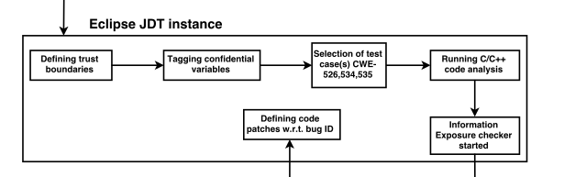

Slide 16
System Overview

Slide 17
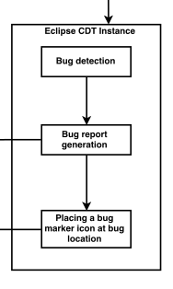

Slide 18
System Overview

Slide 19
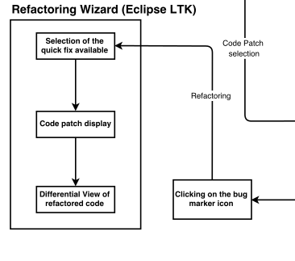

Slide 20
Outline
Introduction
Motivating Example
System Overview
Algorithm
Evaluation
Tool Demo
Conclusion and Future Work

Slide 21
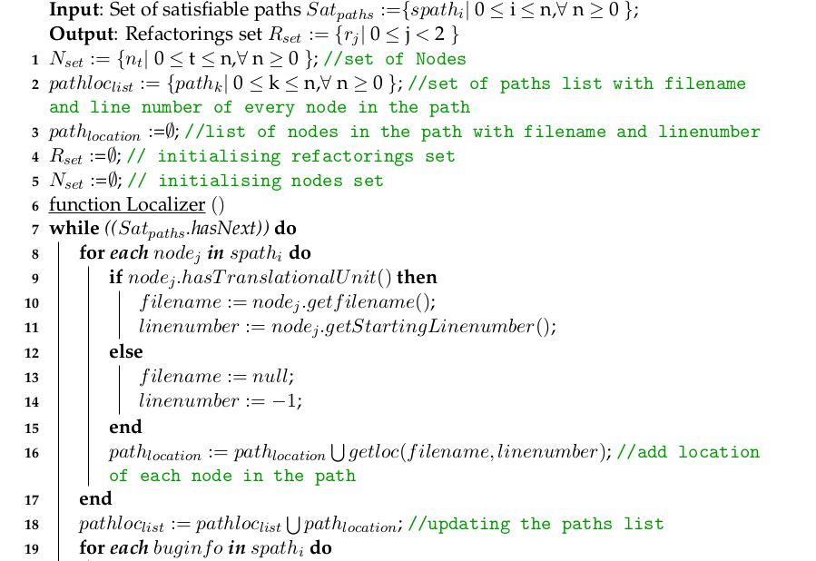
Algorithm
Step 1: Collect all locations of nodes in the
satisfiable paths

Slide 22
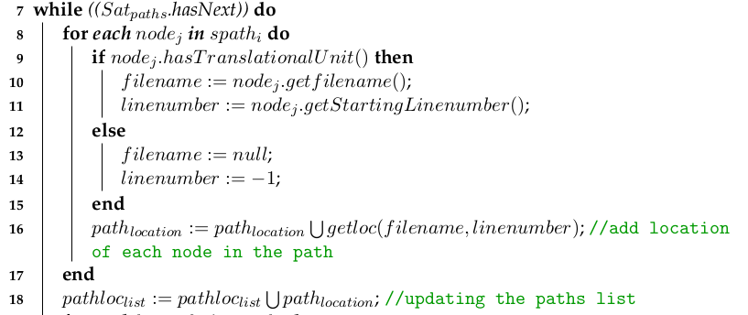

Slide 23
Algorithm continues...
Step 2: Counting each node appearing in all the sat paths

Slide 24
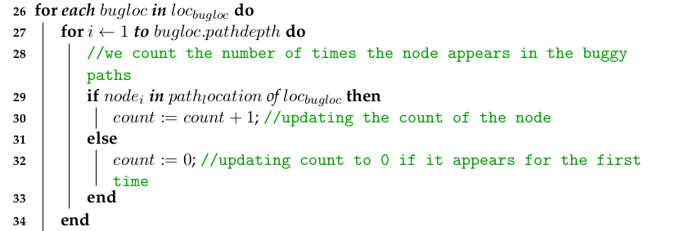

Slide 25
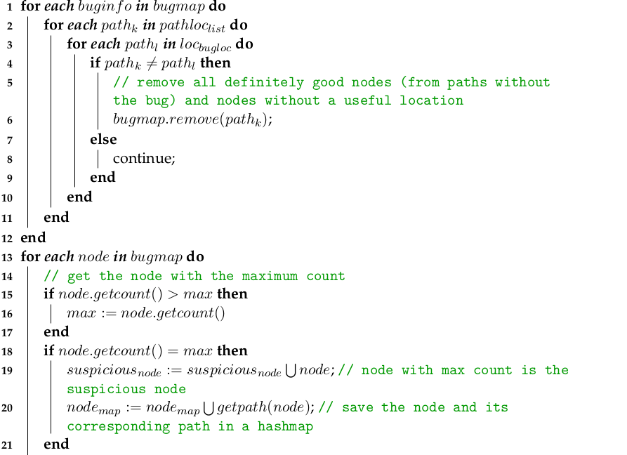
Algorithm continues...
Step 3: Removing all not buggy paths

Slide 26
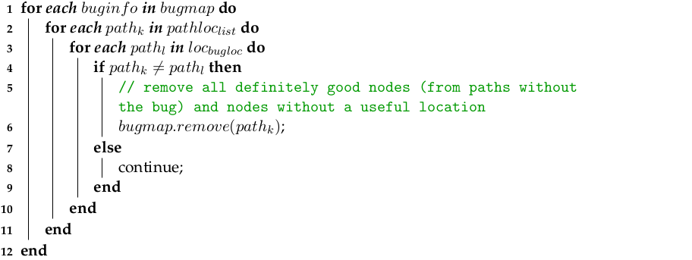

Slide 27
Step 4: Collecting nodes with max count

Slide 28
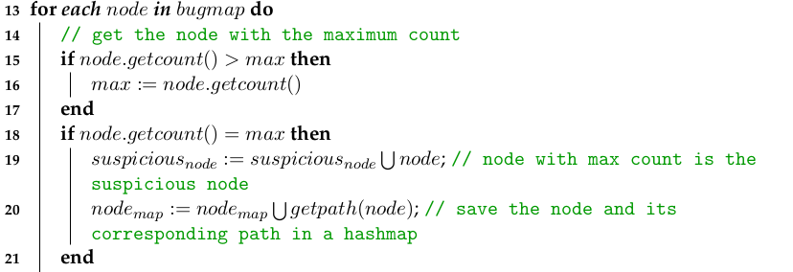

Slide 29
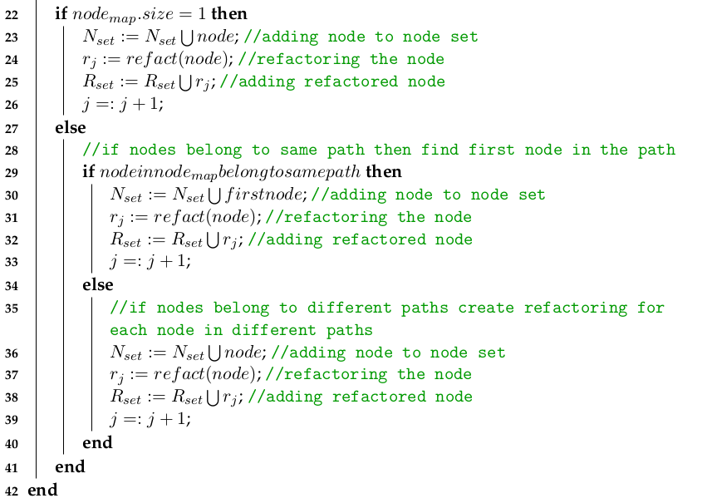
Algorithm continues...

Slide 30
Step I
0
1
2
3
15
17
2
1
10
3
16
5
13
1
8
3
4
7
11
12
1
6
Program Execution Tree

Slide 31
Step II a
0
1
2
3
15
17
2
1
10
3
16
5
13
1
8
3
4
7
11
12
1
6

Slide 32
Step II b
0
1
2
3
15
17
2
1
10
3
16
C(1)=4,
C(2)=2,
C(3)=3,
.
.
.
5
13
1
8
3
4
7
11
12
1
6

Slide 33
Step III a
0
1
2
3
15
17
2
1
10
3
16
C(1)=4,
C(2)=2,
C(3)=3,
.
.
.
5
13
1
8
3
4
7
11
12
1
6

Slide 34
Step III b
0
1
2
3
15
17
2
1
10
3
16
C(1)=4,
C(2)=2,
C(3)=3,
.
.
.
5
13
1
8
3
4
7
11
12
1
6

Slide 35
Step IV
0
1
2
3
15
17
Maximum count
2
1
10
3
16
C(1)=4,
C(2)=2,
C(4)=1,
.
.
.
5
13
1
8
3
4
7
11
12
1
6

Slide 36
Next Steps:
After finding the most suspicious nodes, we then check if the symbolic variables of those nodes are tagged confidential.
Once all these nodes have been collected then we check if all the suspicious nodes belong to the same path or not.
If the nodes belong to the same path, then we find the earliest (program execution order) node that appears in the program execution path.
If the nodes do not belong to the same path, then we create the refactorings for all the nodes.

Slide 37
Outline
Introduction
Motivating Example
System Overview
Algorithm
Evaluation
Tool Demo
Conclusion and Future Work

Slide 38
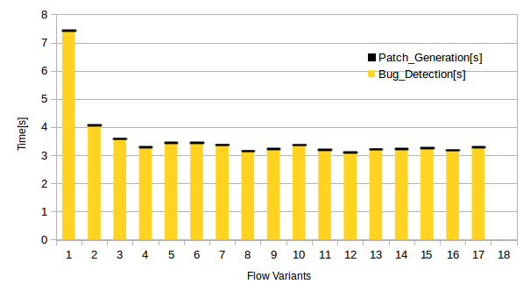
Results I
Patch generation and bug detection times of CWE-526

Slide 39
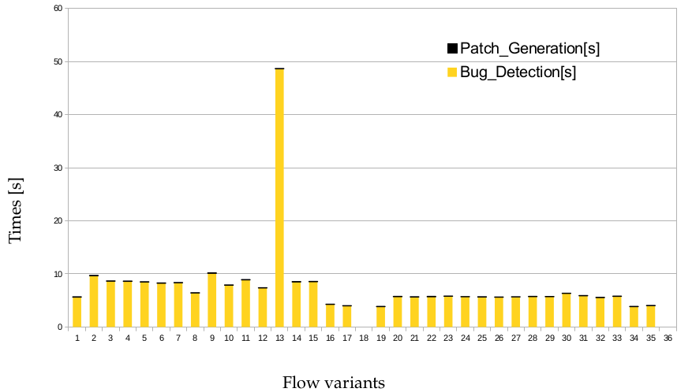
Results II
Patch generation and bug detection times of CWE-534

Slide 40
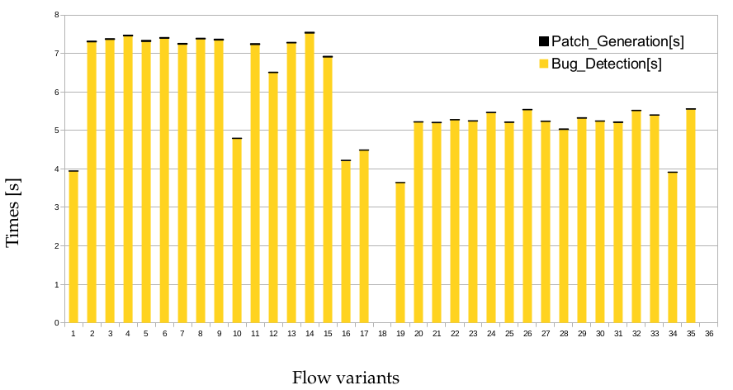
Results III
Patch generation and bug detection times of CWE-535

Slide 41
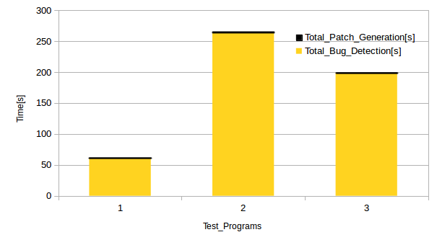
Results IV
Overall overhead

Slide 42
Results V
Test Programs | TPGT[ms] | OTT [ms] | TBDT [ms]
CWE-526 | 0.214 | 61.068 | 60.854
CWE-534 | 0.369 | 264.753 | 264.384
CWE-535 | 0.309 | 199.193 | 198.884
Total | 0.892 | 525.014 | 524.122
Overall overhead
Test Programs | #TTP | #IP | #IPa | % Ratio
CWE-526 | 18 | 0 | 0 | 0
CWE-534 | 36 | 0 | 0 | 0
CWE-535 | 36 | 0 | 0 | 0
Total | 90 | 0 | 0 | 0
Results with respect to program behavior

Slide 43
Results VI
Test Programs | Recompile | In-place-fix | Not-in-place-fix
CWE-526 |  |  | 
CWE-534 |  |  | 
CWE-535 |  |  | 
Usefulness of the patches

Slide 44
Outline
Introduction
Motivating Example
System Overview
Algorithm
Evaluation
Tool Demo
Conclusion and Future Work

Slide 45
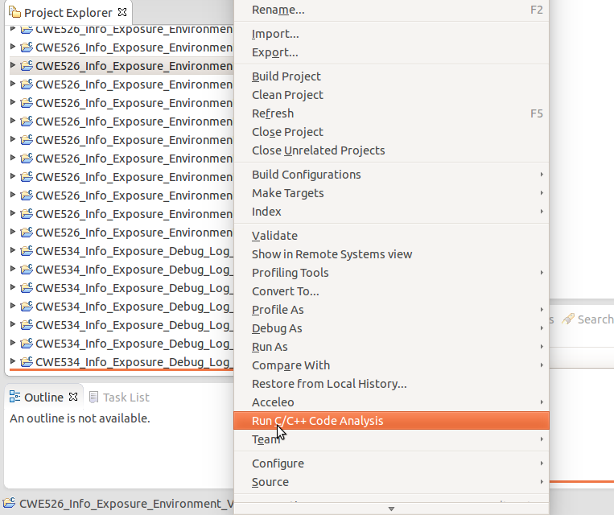
Step I

Slide 46
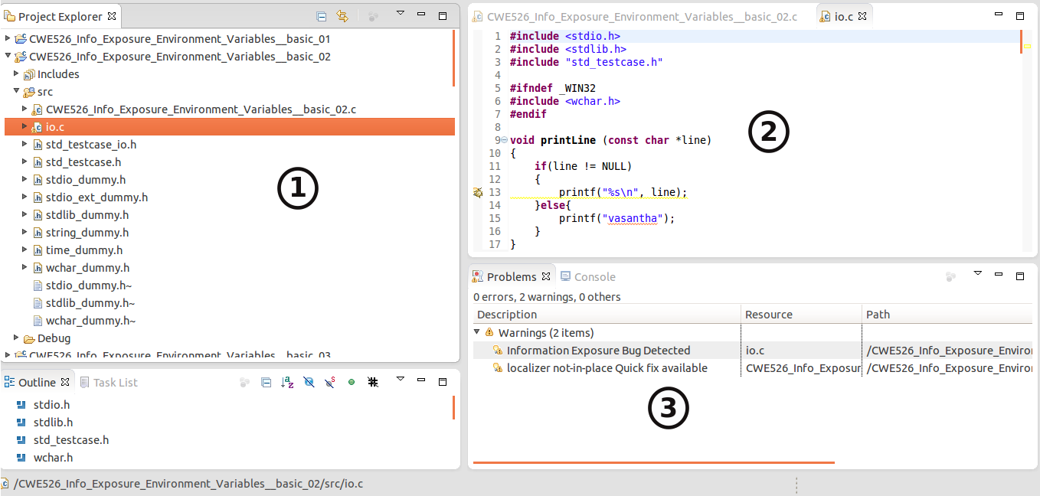
Step II

Slide 47
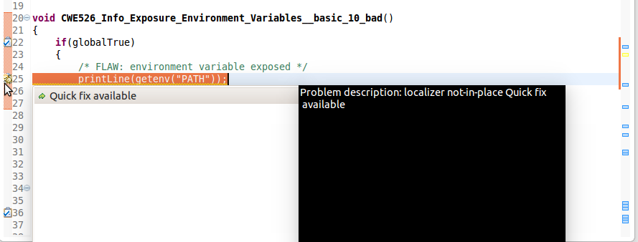
Step III

Slide 48
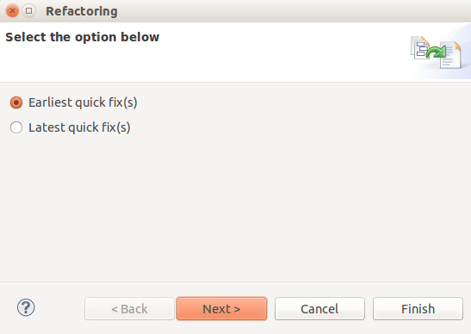
Step IV

Slide 49
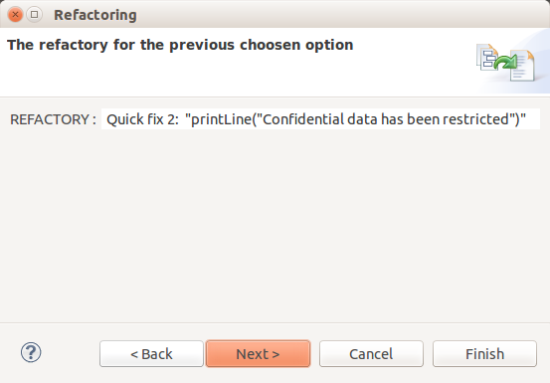
Step V

Slide 50
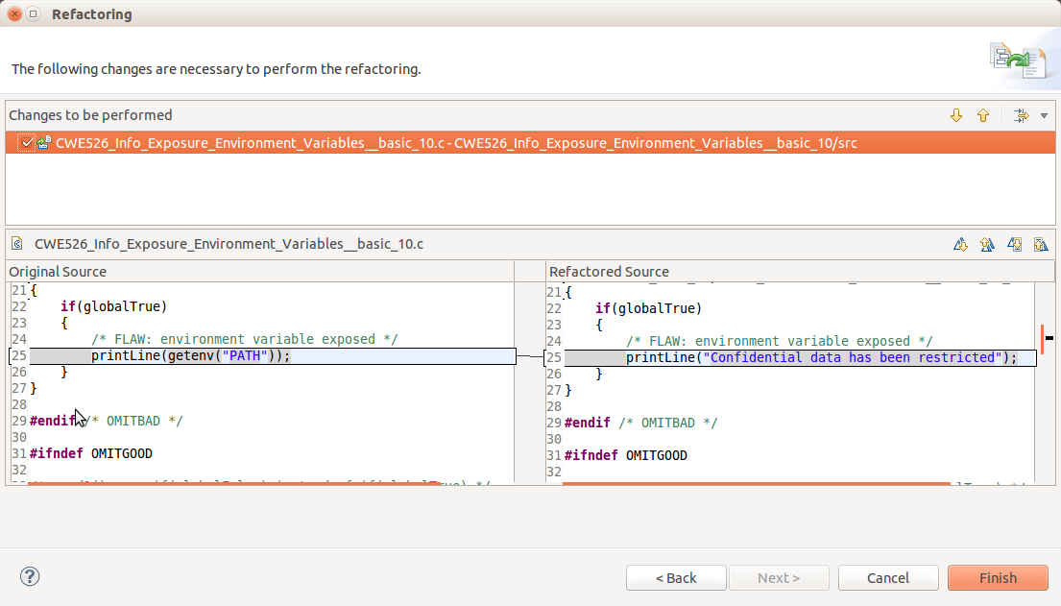
Step VI

Slide 51
Outline
Introduction
Motivating Example
System Overview
Algorithm
Evaluation
Tool Demo
Conclusion and Future Work

Slide 52
Conclusion and Future Work
Codan API was used in order to parse the C/C++ source files present in the Juilet test suite.
Refactoring tool was developed using eclipse LTK.
Localizer filters out all the unsuspicious nodes and then checks for the suspicious nodes if some confidential data flows through them.
The generated code patches could remove all the bugs and also the program behavior is preserved.
In this thesis, we check if the variables between the source to sink paths are tagged confidential. In future one can extend this approach to check the nodes before the source node also.
In future, one can do research on how all the C/C++ libraries can be annotated and how these annotated C/C++ libraries can help while performing static code analysis in order to define the trust- boundaries.

Slide 53
Thank you

